Slide 1
Major topics from ECC strategic plan
Spectrum issues
Peter Faris
4th CEPT Workshop on European Spectrum Management and Numbering
5th April 2016

Slide 2

Overview of spectrum topics from the Strategic Plan
Implementation of a new digital dividend in the 700 MHz band
Spectrum for wireless broadband (including 5G)
Responding to the needs of short range devices including appropriate spectrum access for the Internet of Things
Programme Making and Special Events (PMSE)
Public Protection and Disaster Relief (PPDR)

Slide 3

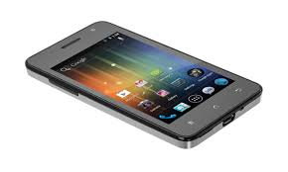
700 MHz – a ‘second digital dividend’
The 694-790 MHz band was allocated to the mobile service on a co-primary basis with broadcasting at WRC-15
Several CEPT countries have already decided to release this band for mobile services
The ECC is responsible for defining the harmonised conditions for mobile and other potential usage of this band

Slide 4



700 MHz harmonised technical conditions
The EC mandated CEPT to develope harmonised technical conditions for the 700 MHz bands
CEPT (through ECC PT1) produced the following deliverables:
  CEPT Report 53 (Nov. 2014)
  ECC Decision (15)01 (March 2015)
  CEPT Report 60 (March 2016)
Technical conditions take into account co-existence with broadcasting and PMSE (wireless microphones) below 694 MHz

Slide 5
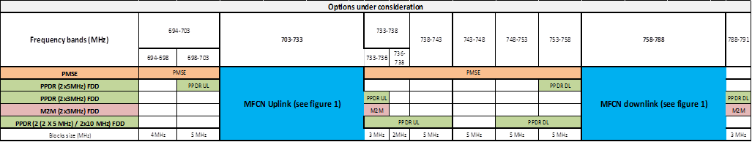



700 MHz band plan
Consistent with lower 30MHz of APT band plan (3GPP band 28)
5 MHz channels
Other uses permitted in the centre gap and guard bands: Supplemental Downlink (SDL) (up to 20 MHz)
  Machine to Machine communications (M2M)
  Public Protection and Disaster Relief (PPDR) – emergency services
  Programme Making and Special Events (PMSE) – wireless microphones

Slide 6
700 MHz cross-border co-ordination
Making 700 MHz available for mobile services requires migration of existing broadcasting services below 694 MHz
Cross-border co-ordination for broadcasting for the whole 470-790 MHz band therefore needs to be facilitated
The ECO, commissioned by the ECC, has developed an information repository which contains the status of the co-ordination process submitted by administrations.

Slide 7

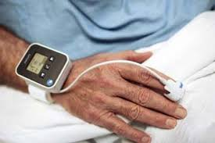



What is 5G?
‘5G’ is a concept currently under development and discussion within academia, industry, regulation and standardisation
The aim is to provide:
  Higher data-rates – peak rates of tens of Gbps
  Low latency – order of 1 ms
  Increased density of devices – 1 million per km²
Seamless connectivity and user experience
To support a range of applications (not just mobile broadband):
  ‘Internet of things’ and M2M
  Automotive (LTE V2X)
  Home automation
  Industrial automation and sensors
  Healthcare

Slide 8
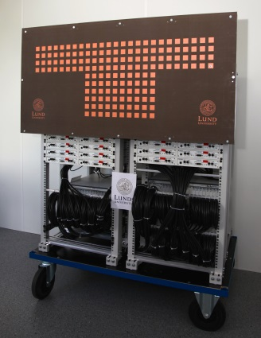
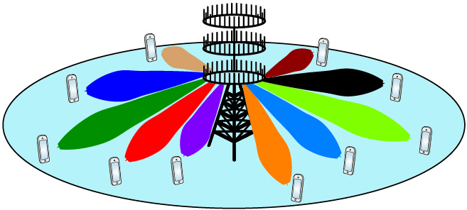
5G technical requirements
5G is aimed to be released around 2020
In order to meet the ambitious capacity targets, wide channel bandwidths are required – 100s of MHz or even several GHz!
Smart antenna technology (‘massive MIMO’) is being researched to provide localised coverage to individual users from a dense network of base stations
All of this points to a requirement for large amounts of spectrum in higher frequency bands – up to around 90 GHz

Slide 9
Spectrum for 5G - Existing
Regulation for mobile broadband is technology neutral
  Bands already harmonised in Europe might be used for 5G
  Some adaptations may be needed to accommodate 5G characteristics (small cells? BEM?)
Bands with limited use and large bandwidth (e.g. 2.3-2.4 GHz and 3.4-3.8 GHz) could be envisaged for early introduction of 5G in lower bands

Slide 10


Spectrum for 5G - Additional
WRC-15 identified the following frequency ranges to be studied for future wireless broadband usage (including 5G):
  24.25-27.5 GHz
  31.8-33.4 GHz
  37-43.5 GHz
  45.5-50.2 GHz
  50.4-52.6 GHz
  66-76 GHz
  81-86 GHz
Compatibility studies with other systems in these and adjacent bands will be considered under Agenda Item 1.13 in WRC-19

Slide 11

Spectrum for 5G – ECC activites
ECC PT1 has started work to participate in the ITU-R activities (through WP 5D)
  Work is at an early stage, and is focussing on technical requirements and evaluation methods
  5G technology developments will be considered at the upcoming meetings
CPG-19 has not yet decided on how work on 5G issues will be organised for CEPT preparation for WRC-19
Other issues, such as infrastructure, numbering and backhaul requirements will also need to be considered

Slide 12



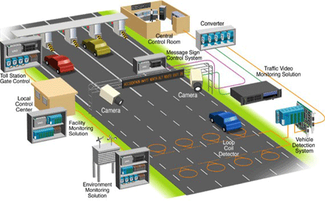
Spectrum needs for short range devices and the Internet of Things
There is an ongoing need to provide spectrum for short range devices
Applications include:
  Smart energy grids
  Smart meters
  Intelligent Transport Systems (ITS)
  The ‘Internet of Things’
  Machine to Machine Communications (M2M)

Slide 13
Spectrum needs for short range devices and the Internet of Things
The ECC recently developed band plans for 870-876 MHz and 915-921 MHz to enable administrations to make spectrum available for SRD
The ECC will continue to respond to industry demand by identifying common frequency bands for SRDs under appropriate sharing regimes (e.g. 1900-1920 MHz)
CF 916.3 MHz
CF 917.5 MHz
CF 918.7 MHz
CF 919.9 MHz
RFID 4W
SRD 100 mW 1% DC
ALD 10 mW. 25% DC
RFID 4W
SRD 100 mW 1% DC
ALD 10 mW. 25% DC
RFID 4W
SRD 100 mW 1% DC
ALD 10 mW. 25% DC
RFID 4W
SRD 100 mW 1% DC
ALD 10 mW. 25% DC
500 mW (with APC), ≤200 kHz Up to 2.5% DC Metropolitan/Rural Area Networks.
Up to 10% DC for Network Relay Points
(subject to individual license)(ERC Rec 70-03 Annex 2)
500 mW (with APC), ≤500 kHz, 0.1 % DC TTT Vehicle to Vehicle only (ERC Rec 70-03 Annex 5)
100 mW (with APC) 0.1% DC TTT in vehicle only (ERC Rec 70-03 Annex 5)
200 kHz of low DC safe haven
RFID tag return
RFID tag return
RFID tag return
RFID tag return
RFID tag return
200 kHz Low DC safe haven
25mW 1% DC ≤600 kHz (ERC Rec 70-03 Annex 1)
25 mW 1% DC Per 600 kHz channel. Channel bandwidth ≤ 600 kHz
25mW 0.1% DC ≤200 kHz (ERC Rec 70-03 Annex 1)
25 mW 0.1% DC Per 200 kHz channel. Channel bandwidth ≤ 200 kHz
SRD
ER-GSM 873-876 MHz
R-GSM
GSM mobile
ER-GSM (base stations)
918-921 MHz
R-GSM
915MHz
915.3 MHz
916.1 MHz
916.5 MHz
917.3 MHz
917.7 MHz
918.5 MHz
918.9 MHz
919.7 MHz
920.1 MHz
920.9 MHz
870
MHz
875.8 MHz
921 MHZ
875.6
MHz
876
MHz

Slide 14


Programme Making and Special Events (PMSE)
PMSE applications inlclude wireless microphones and related audio applications (talk-back, ear monitors), as well as wireless cameras (e.g. Newsgathering)
Recently available spectrum has been reduced – e.g. the digitial dividend (700 MHz and 800 MHz)
The ECC will designate necessary spectrum for PMSE, taking into account:
  The possibility to use higher frequencies
  New digital technology and cognitive solutions
  The need to maintain existing production quality
Possible opportunities under study in particular in 1350-1400 MHz (wireless microphones) and 2.7-2.9 GHz (wireless cameras)

Slide 15


Public Protection and Disaster Relief (PPDR)
Spectrum needs for PPDR (emergency services) have been raised during the last few years and the ECC is investigating solutions
Broadband services including video are required
Priority, availability and security are key issues
Harmonisation will require a long term effort both by ECC and at national level
Recent developments on harmonisation in 400 MHz and 700 MHz (Draft ECC Decision (16)02)

Slide 16
Thank you - any questions?

